Slide 1
Waste Sorter
Von Team Scheming Frogs

Slide 2
Pain point
1.4 Billion people visited another country in 2018
The tourists have problem to throw the garbage into correct bin
Higher costs for government to sort out the unsorted trash

Slide 3
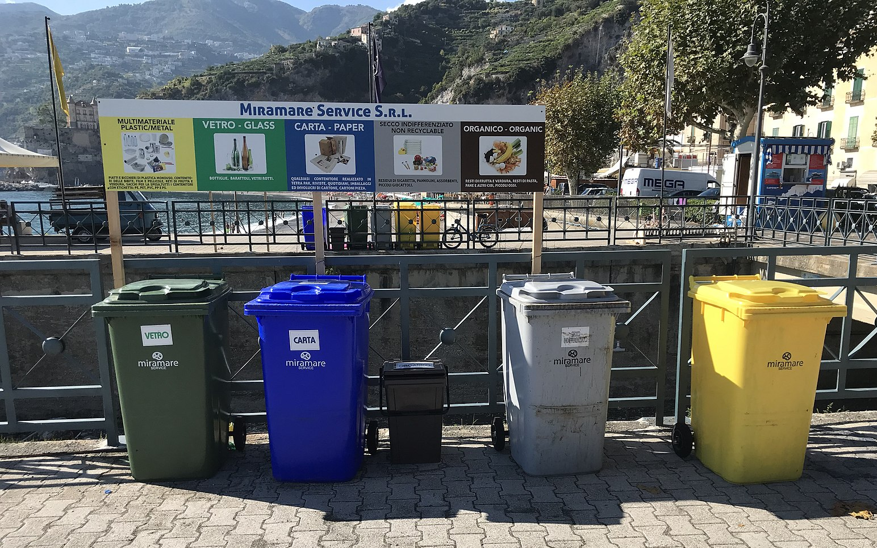
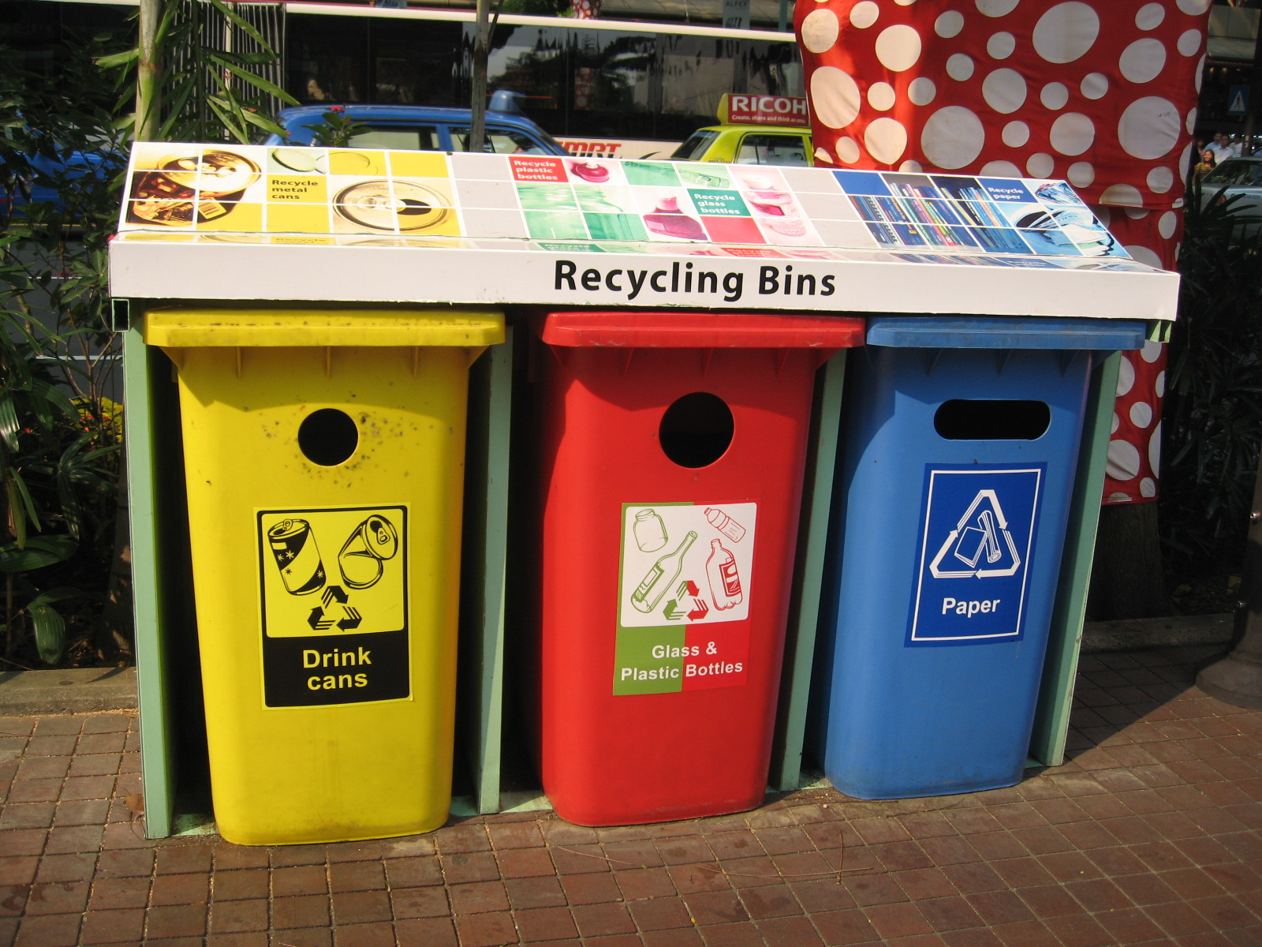
Different recycle system in the world
Italy
Singapore

Slide 4
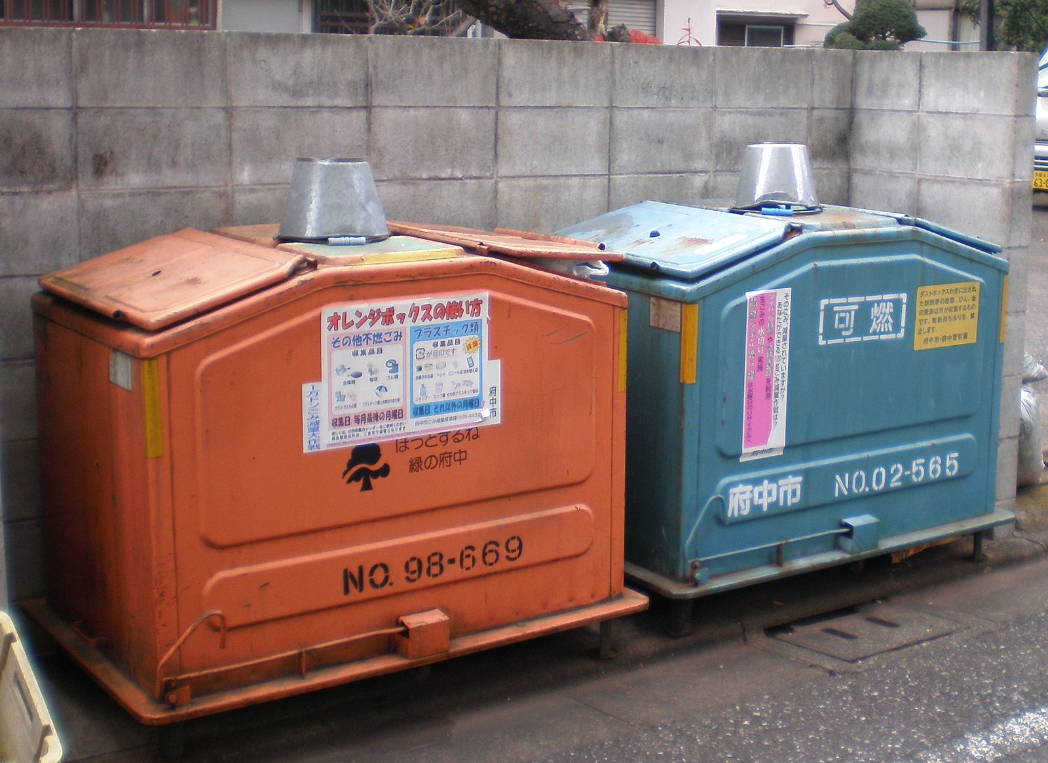
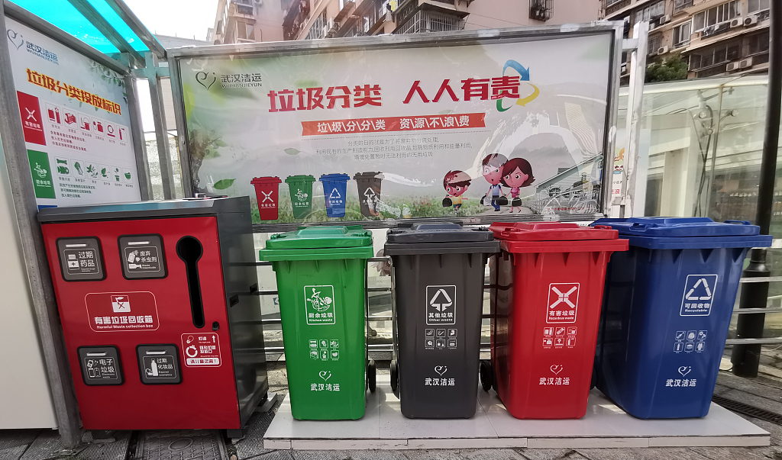
Different recycle system in the world
Japan
China

Slide 5
Solution
Waste sorter tells our app user:
1. which type of the garbage it is?
2.which bin should the garbage belongs to in each country you travel to?

Slide 6
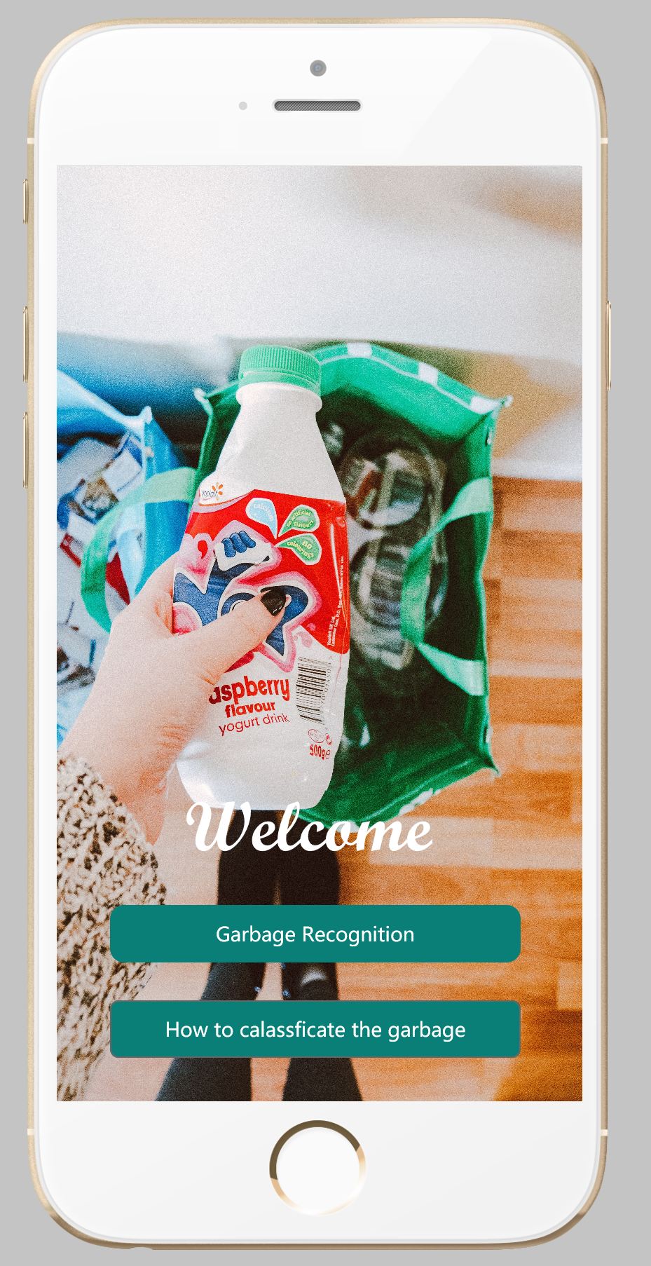
App User Interface
Garbage recognition
How to classify the garbage

Slide 7
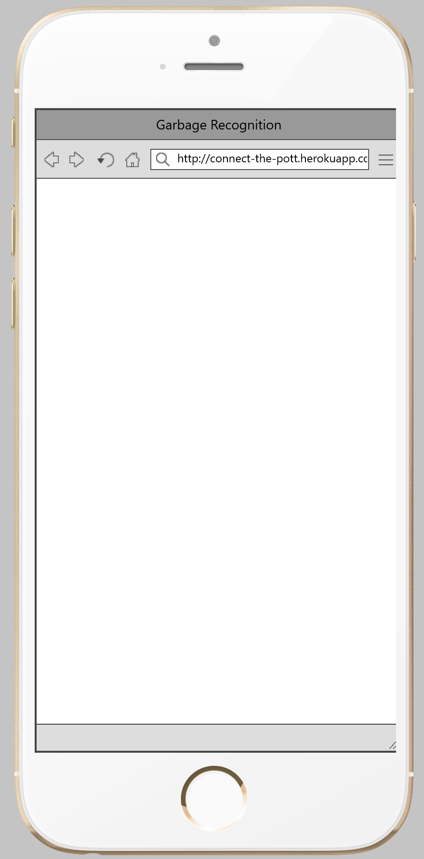
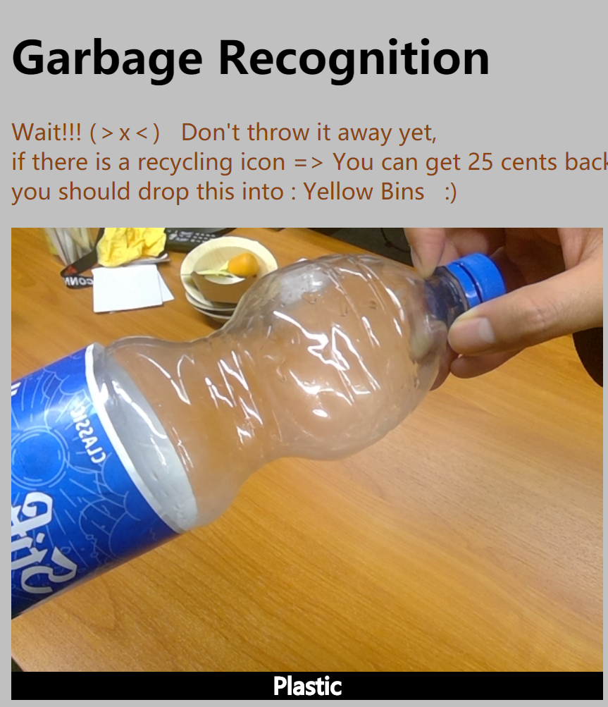


Garbage recognition
1. The App let you know what type of garbage it is?
2. For example in Germany, you can get 25 cent Euros back in every super market!

Slide 8
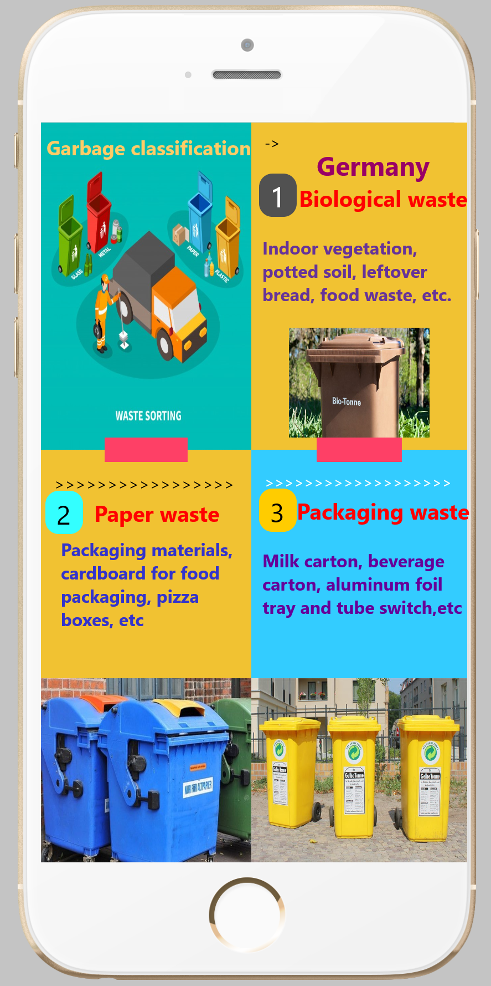
How to classify the garbage
The App will detect your location, and tell you the specific recycle rules in each country!

Slide 9
Application
Teachable Machine
mockplus

Slide 10
Reference
https://en.wikipedia.org/wiki/File:Garbage_containers_at_fuchu_city.jpg
https://en.wikipedia.org/wiki/File:NEA_recycling_bins,_Orchard_Road.JPG
https://en.wikipedia.org/wiki/File:Waste_sorting_in_Porto_Venere.jpg
http://images.china.cn/site1007/2019-07/09/070aa828-3699-4f77-bdda-2ba15d405e6a.jpg
https://de.wikipedia.org/wiki/Datei:Mueltrennung-Italien-Maiori-2019.jpg

